Slide 1
读书报告
Monocular Real-Time Volumetric Performance Capture
单目实时体积性能捕获
ECCV 2020

Slide 2
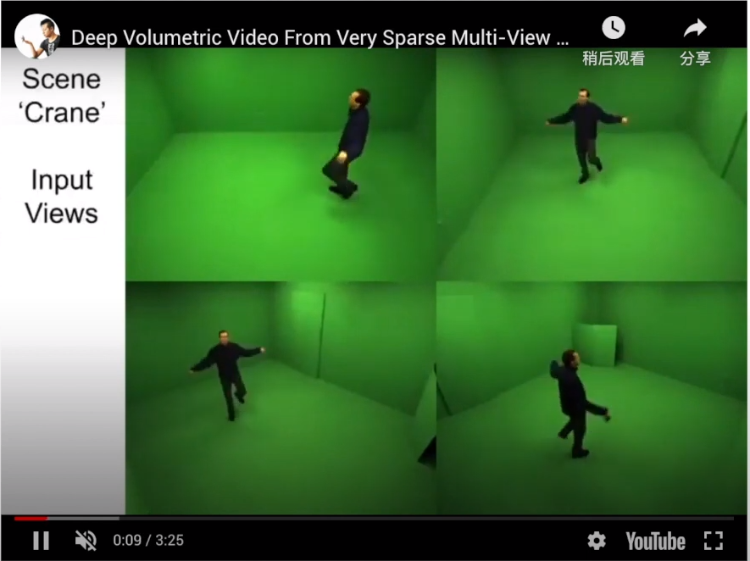
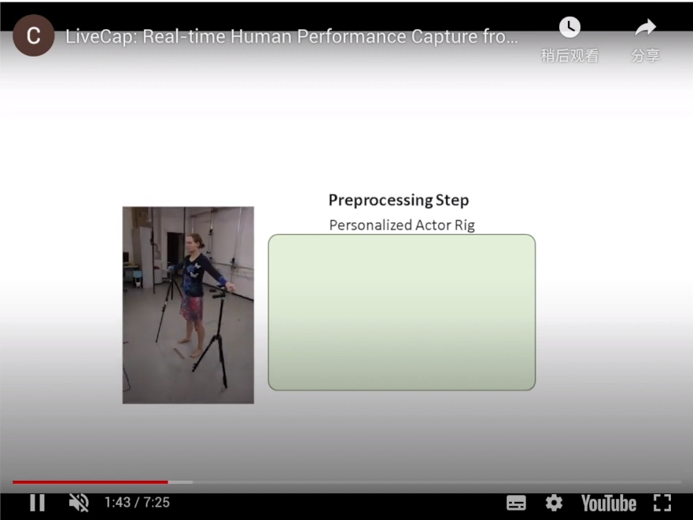
复杂的捕获系统
多相机系统
预捕获模板

Slide 3
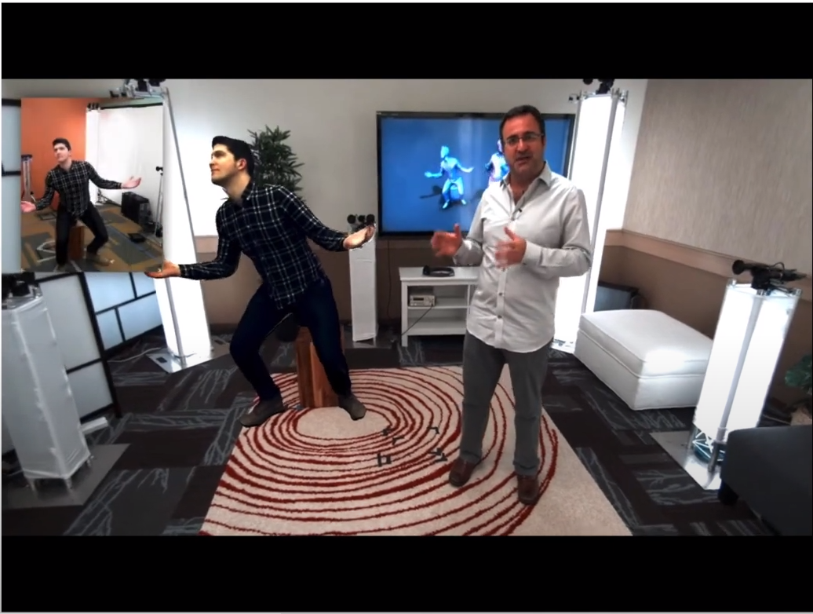
单一RGB相机下的3D视频会议？

Slide 4
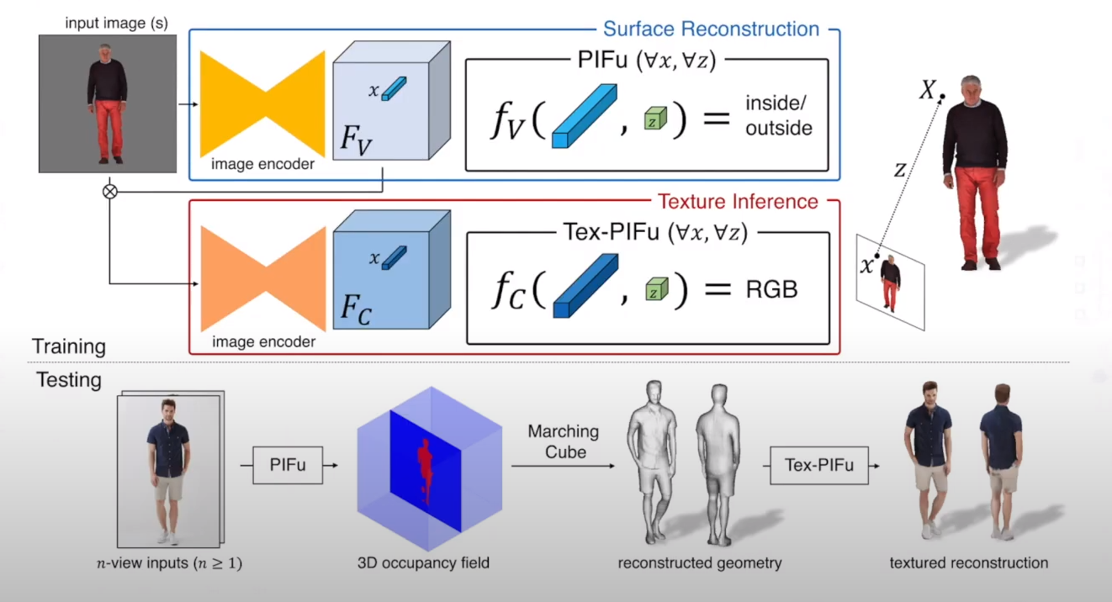
Pixel-Aligned Implicit Function（PIFu）

Slide 5
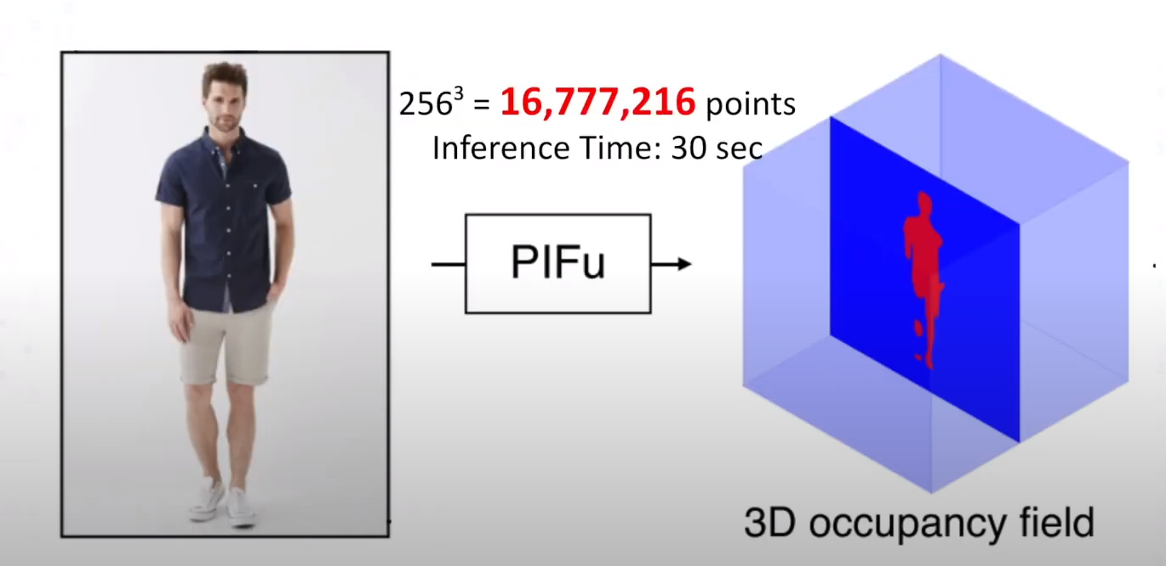
Pixel-Aligned Implicit Function（PIFu）

Slide 6
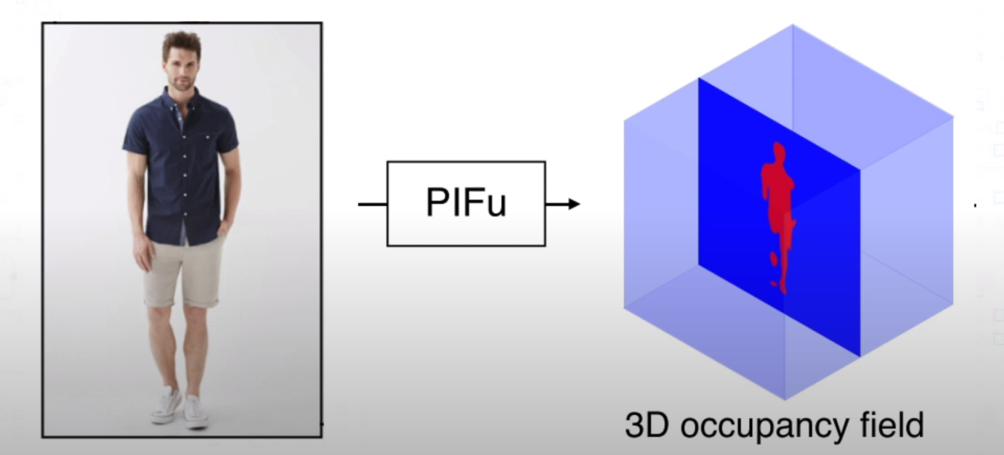
Pixel-Aligned Implicit Function（PIFu）
Given an implicit query function
How to find a surface with minimal number of queried points?

Slide 7
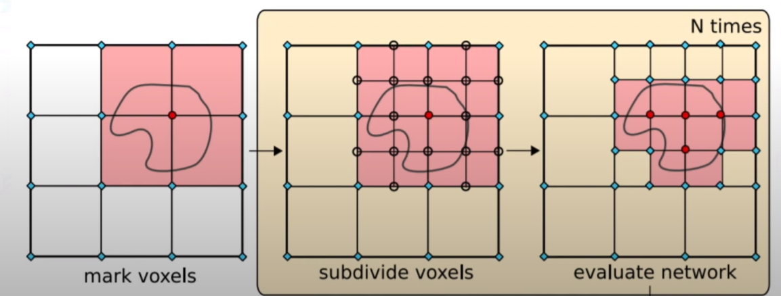
Related Work: Octree based Surface Localization
Given an implicit query function
How to find a surface with minimal number of queried points?

Slide 8
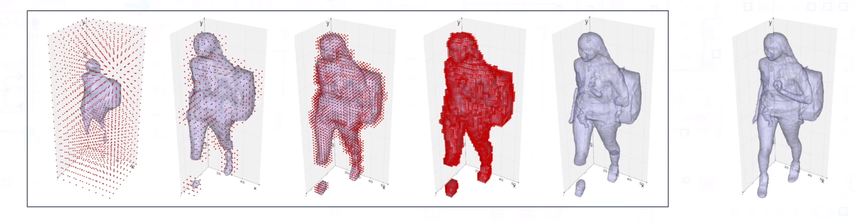
Related Work: Octree based Surface Localization
Given an implicit query function
How to find a surface with minimal number of queried points?
Octree Recon
Brute-force Recon

Slide 9
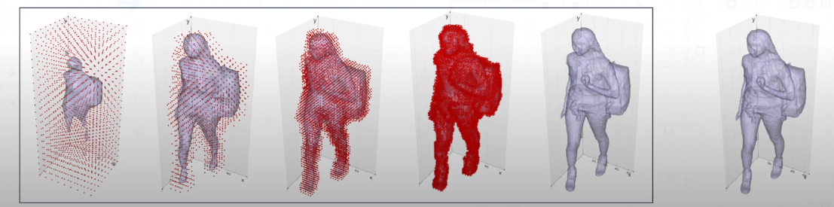
Lossless Octree Surface Localization
Find the 100% correct surface with minimal number of queried points
Lossless Octree Recon
Brute-force Recon

Slide 10
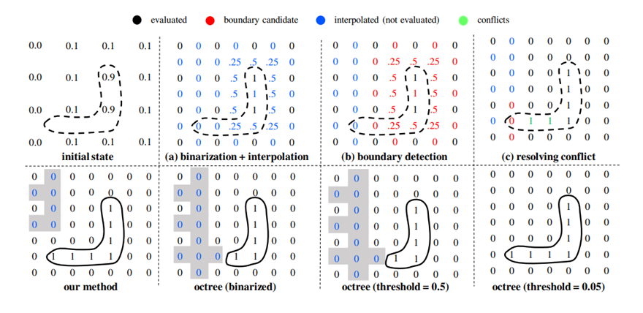
Method Comparison

Slide 11
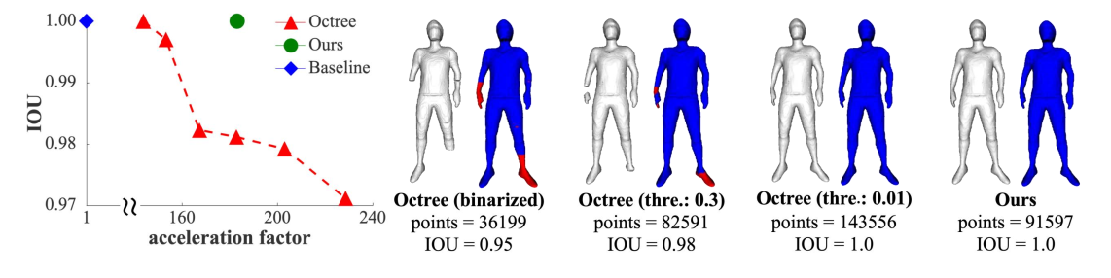
Naïve Octree vs Lossless Octree

Slide 12
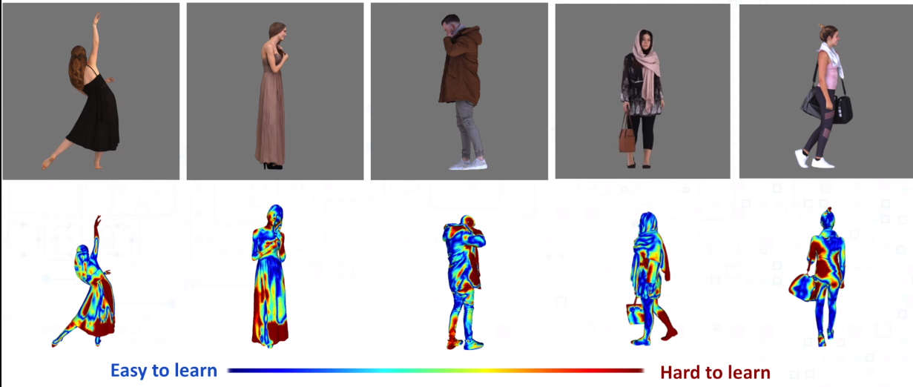
Online Hard Example Mining Algorithm

Slide 13
Result
https://www.bilibili.com/video/BV1Rt4y1Q7hF

